Slide 1
Default WIFI MAC Layer in NS3 and Relevant Helpers
Submitted by
Kowshic Roy (1705001)
Saem Hasan (1705027)

Slide 2
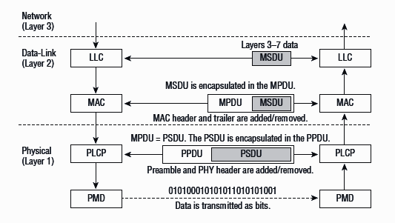
Wifi MAC layer : Some Basics
Coordinates access to the shared physical air interface .
MAC takes data from a higher sub-layer called LLC, adds header and tail bytes, and sends them to lower physical layer for transmission.

Slide 3
WIFI Mac Layer : The WorkFlow
void ns3::YansWifiChannelHelper::AddPropagationLoss()
void ns3::YansWifiChannelHelper::SetPropagationDelay()

Slide 4
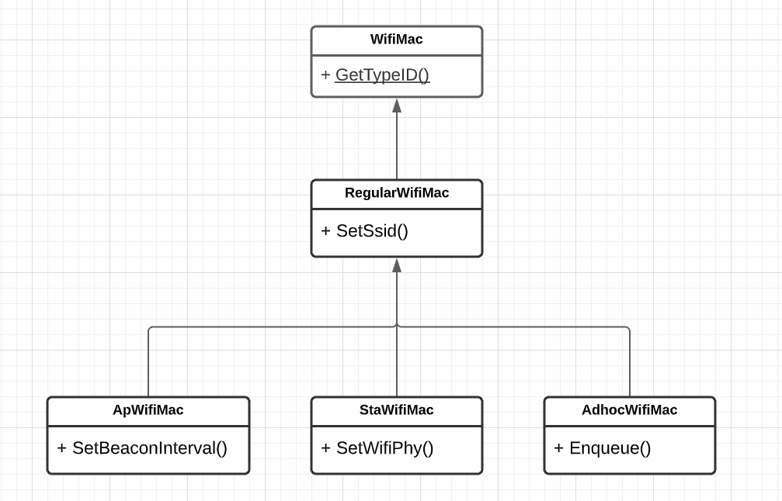
Wifi : Node Type
3 types of elements in Wifi topologies.
Access Point (AP).
non-AP Station (STA).
STA in an Independent Basic
Service Set( Ad hoc ).

Slide 5

Wifi : Access Points
A device that creates a wireless LAN.
Projects a Wi-Fi signal to a designated area.
Allows other Wi-Fi devices to connect to a wired network.

Slide 6
Wifi : Connection Establishment
How does a Wi-Fi station discover and associate with an AP?
Passive Scanning ( NS3 Default ).
Active Probing.

Slide 7
Wifi : Two Physical Layer Model
YansWifi
- Our main focus.
-Why it is named after Yans?
Yet Another Network Simulator.
SpectrumWifi

Slide 8
Wifi : Two Important Unit
Channel Model ( YansWifiChannel ).
Physical layer Model ( YansWifiPhy ).

Slide 9
Trivial Node Creation
Nodes are created and maintained using NodeContainer.
Some nodes should be chosen as Access Point.
NodeContainer wifiStaNodes;
wifiStaNodes.Create(3);
NodeContainer p2pNodes;
p2pNodes.create(1);
NodeContainer wifiApNode = p2pNodes.Get(0);

Slide 10
WIFI : YansWifiChannel
Uses
The propagation loss.
The delay models.
From Propagation module.

Slide 11
YansWifiChannelHelper : Defaults
YansWifiChannelHelper channel = YansWifiChannelHelper::Default();
Default includes
A propagation delay equal to a constant, the speed of light.
A propagation loss based on a log distance model with a reference loss of 46.6777dB at reference distance of 1m.
Other default wifi standards to 802.11a.
Notes:
Create a channel helper in a default working state.
propagation loss based on a default log distance model (ns3::LogDistancePropagationLossModel)

Slide 12
YansWifiChannelHelper : Tweaks
channel.SetPropagationDelay ("ns3::ConstantSpeedPropagationDelayModel");
channel.AddPropagationLoss ("ns3::FriisPropagationLossModel");
If one or more PropagationLossModels already exist, the new model is chained to the end.
Delay propagation is replaced but not chained.

Slide 13
WIFI : YansWifiPhyHelper
Modeling the reception of packets.
Tracking energy consumption.
YansWifiPhyHelper phy = YansWifiPhyHelper::Default ();
phy.SetChannel(channel.Create());

Slide 14
WifiHelper : Rate Control
Rate Control Algorithms
Aarf
Arf
Cara
Rraa
ConstantRate
WifiHelper wifi;
wifi.SetRemoteStationManager("ns3::AarfWifiManager");
Notes:
Rate control algorithms adapt the transmission rate dynamically to the changing channel conditions, so the performance of the radio link can be maximized.It is not obvious which rate works the best with what channel conditions. The goal of rate control algorithms is to find the best rate and maximize throughput.

Slide 15
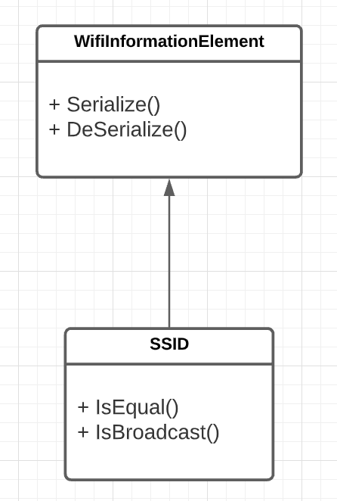
SSID
Captures relevant access information.
Ssid ssid = Ssid("ns-3-ssid");

Slide 16
WifiMacHelper : STA Node
WifiMacHelper mac;
mac.SetType("ns3::StaWifiMac",
"Ssid", SsidValue(ssid),
"ActiveProbing", BooleanValue(false));
NetDeviceContainer staDevices;
staDevices = wifi.Install(phy, mac, wifiStaNodes);

Slide 17
WifiMacHelper : Node as Access Point
mac.SetType("ns3::ApWifiMac",
"Ssid", SsidValue(ssid));
NetDeviceContainer apDevices;
apDevices = wifi.Install(phy, mac, wifiApNode);

Slide 18
WifiHelper : Choosing Standards
The following values for WifiStandard are defined in src/wifi/model/wifi-standards.h:
WIFI_STANDARD_80211a,
WIFI_STANDARD_80211b,
WIFI_STANDARD_80211g,
WIFI_STANDARD_80211p,
WIFI_STANDARD_80211n,
WIFI_STANDARD_80211ac,
WIFI_STANDARD_80211ax
Channel settings should be compatible with standards.
There is a unique ns3::WifiPhy attribute, named ChannelSettings, that enables to set channel number, channel width, frequency band and primary20 index all together, in order to eliminate the possibility of inconsistent settings.
Notes:
a channel in the 2.4 GHz band cannot be configured if the standard is 802.11ac,
or a channel in the 6 GHz band can only be configured if the standard is 802.11ax (or beyond).

Slide 19
WifiHelper : Choosing Standards
WifiHelper wifi;
wifi.SetStandard (WIFI_STANDARD_80211n);
YansWifiPhyHelper phyHelper;
phyHelper.Set ("ChannelSettings", StringValue ("{38, 40, WIFI_PHY_BAND_5GHZ, 0}"));
It is set to channel 38 (first 40 MHz channel in the 5GHz band)
Notes:
the operating channel will be channel 38 in the 5 GHz band, which has a width of 40 MHz, and the primary20 channel will be the 20 MHz subchannel with the lowest center frequency (index 0).

Slide 20
Have any Question ?

